Slide 1
MACHINE LEARNING PROJECT
PERSONALIZED LEARNING
RECOMMENDATION SYSTEM
A data-driven approach to recommending suitable learning resources for students
Presented by: Swastika Barai
Roll No.: 24103460064
Student Code: BWU/BCA/24/066 | Department: BCA
Subject: Machine Learning | Subject Code: BCA57205

Slide 2
Introduction
01 • OVERVIEW
• Students learn at different speeds and have different interests, strengths and preferred learning styles.
• A single learning resource may not be equally useful for every student.
• This project explores how machine learning can use student learning information to suggest suitable resources.
• The current prototype generates a student dataset, analyses it, trains a classification model and produces a recommendation.
INPUT
PROCESS
OUTPUT
Student scores, study habits, interests and learning preferences.
Data preparation, feature encoding and Random Forest model.
A suggested learning resource for the student.
02

Slide 3
Problem Statement
02 • PROBLEM
The problem
Students often receive the same learning materials even though their academic performance, interests and learning preferences are different.
ONE-SIZE-FITS-ALL
DIFFICULT CHOICE
LIMITED GUIDANCE
Generic resources may not match each learner's current level or interest.
Students may find it difficult to decide what to study next.
Without analysing learner information, recommendations may be less relevant.
03

Slide 4
Objectives
03 • GOALS
• Create a structured dataset containing student academic and learning-profile information.
• Clean and explore the data to understand its patterns and distributions.
• Identify useful input features such as previous score, quiz score, study hours and interest.
• Train a machine-learning classification model to predict a recommended resource category.
• Evaluate the model using test data, accuracy, classification report and confusion matrix.
• Build a simple interactive input flow that returns a recommendation.
04

Slide 5
Scope of the Project
04 • COVERAGE
TARGET USERS
PROJECT COVERAGE
EXPECTED USE
Students who need guidance in choosing a learning resource or practice activity.
Student profile data, exploratory analysis, preprocessing, model training, evaluation and resource prediction.
A prototype that demonstrates how learner information can support resource selection.
Current limitations
• The current dataset is synthetically generated for project development and demonstration.
• Recommendations are limited to the resource categories represented in the dataset.
• The prototype is not yet connected to a live learning-management platform or real student records.
• Results must be validated with real student data before practical deployment.
05

Slide 6
Literature Review / Existing System
05 • BACKGROUND
TRADITIONAL LMS / COURSE CATALOGUES
RULE-BASED RECOMMENDATIONS
Usually organise lessons, videos, quizzes and progress tracking. Students may still need to choose resources themselves.
Can suggest content using fixed conditions (for example, a score threshold or selected topic). They are simple but may not capture multiple patterns.
Identified gap
A recommendation process that combines several learner attributes and learns patterns from example data can provide a useful starting point for more personalised guidance.
This project is a prototype and does not claim to replace established learning platforms.
07

Slide 7
Proposed System
06 • SOLUTION
The proposed system accepts student learning details, processes them using a trained Random Forest classifier and returns a suitable resource category.
1. STUDENT INPUT
2. ML PROCESSING
3. RECOMMENDATION
Previous score
Quiz score
Study hours
Interest and learning style
Completed topics
Preprocessing pipeline
One-hot encoding
Random Forest classifier
Predicted resource class
Beginner Tutorial
Python Practice
SQL Practice
Machine Learning Tutorial
Other supported categories
Key feature: the same preprocessing steps are applied to training data and new student input through a single pipeline.
08

Slide 8
Project Methodology & Technologies
07 • METHOD
1. Dataset creation
2. Data preparation
3. EDA
4. Preprocessing
Generate student learning records
Check shape, missing values and duplicates
Visualise scores, interests and learning styles
Encode categorical fields and pass numeric fields
5. Model training
6. Evaluation
7. Recommendation
Train Random Forest classifier
Test predictions and review metrics
Collect student input and predict a resource
Technologies
Python | NumPy | Pandas | Matplotlib | scikit-learn | Joblib | VS Code
Database: CSV file storage is used in the current prototype; no separate database server is implemented.
09

Slide 9
Project Internal Structure
08 • ARCHITECTURE
Student details
(input form)
Dataset
(CSV)
Preprocessing
pipeline
Random Forest
classifier
Output
(recommendation)
Evaluation
(metrics/graphs)
Saved model
(Joblib)
Predicted resource
category
Conceptual architecture of the current Python prototype. The saved model is reused for prediction; CSV is used for dataset storage.
Main modules: data generation • cleaning • EDA • preprocessing • model training • evaluation • prediction
10

Slide 10
Implementation: Dataset & Data Preparation
09 • IMPLEMENTATION
• A synthetic dataset of 500 student records is generated for development and demonstration.
• The records include academic scores, study hours, interests, learning styles, completed topics and other learning attributes.
• Pandas is used to inspect the dataset, count missing values and identify duplicate rows.
• The cleaned dataset is saved as a CSV file in the outputs folder.
• Matplotlib graphs are generated to understand the distribution of student attributes.
DATASET SIZE
500 generated student records
STORAGE
outputs/student_learning_dataset.csv
DATA QUALITY CHECKS
Dataset shape • missing values • duplicate rows
11

Slide 11
Implementation: Machine-Learning Model
09 • IMPLEMENTATION
INPUT FEATURES
PREPROCESSING
CLASSIFIER
Numeric: previous score, quiz score, study hours
Categorical: interest, learning style, completed topics and other profile fields
ColumnTransformer + OneHotEncoder for categorical features; numeric features passed through.
RandomForestClassifier learns patterns between student features and the target resource category.
Training and prediction flow
• Split the dataset into training and testing subsets (80:20 in the current implementation).
• Fit the preprocessing and Random Forest model on the training subset.
• Evaluate predictions on the held-out test subset.
• Save the trained pipeline using Joblib and use it to predict a recommendation for new student details.
The Random Forest classifier is the machine-learning model; the preprocessing pipeline prepares input features for it.
12

Slide 12
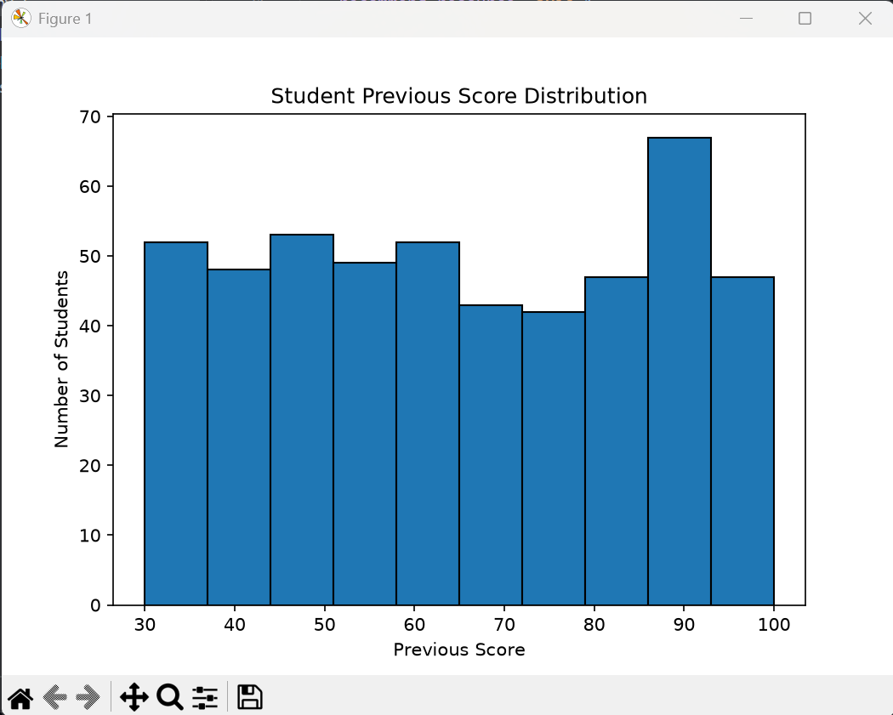
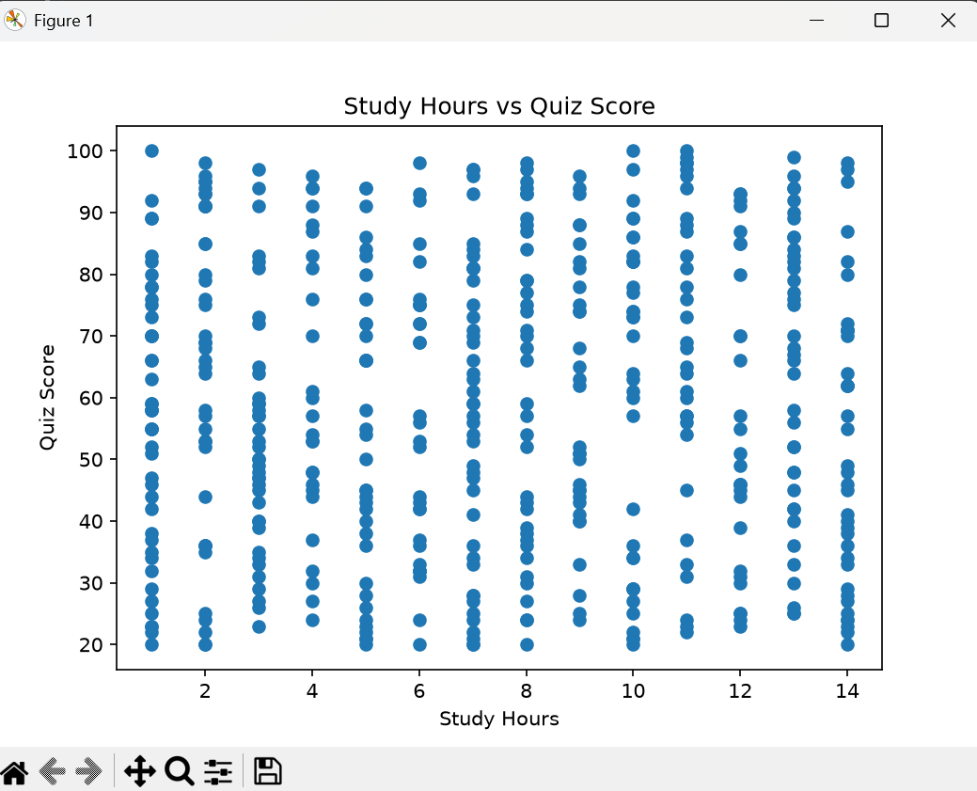
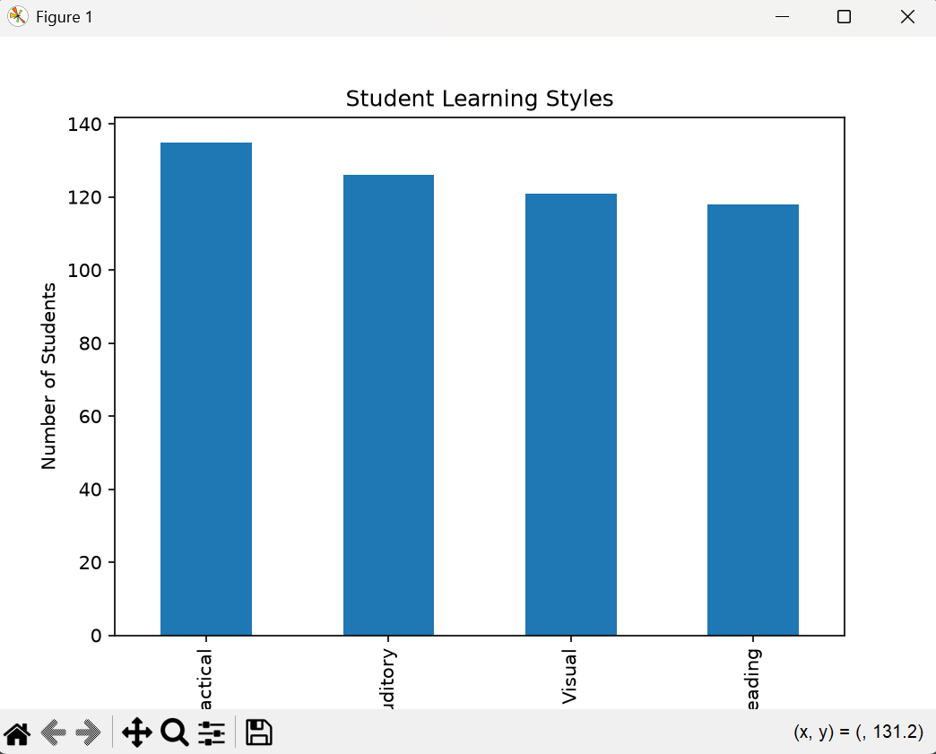
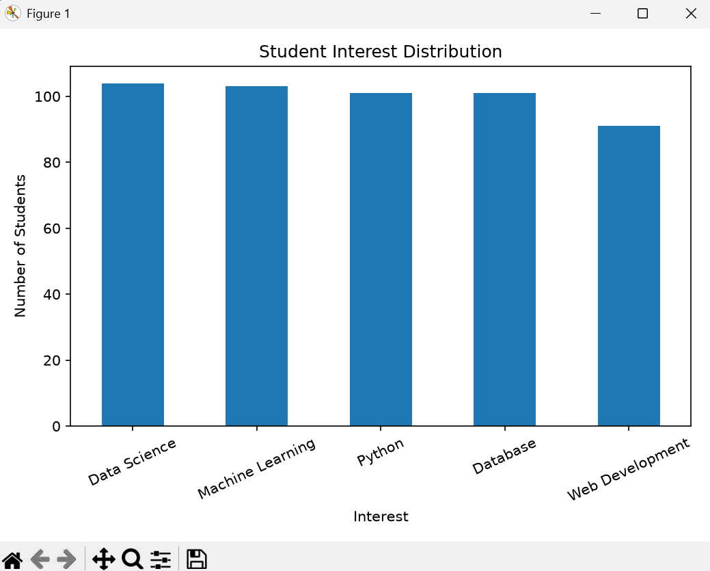
Implementation: Exploratory Data Analysis
09 • IMPLEMENTATION
Previous score distribution
Study hours vs quiz score
Student learning styles
Student interest distribution
13

Slide 13
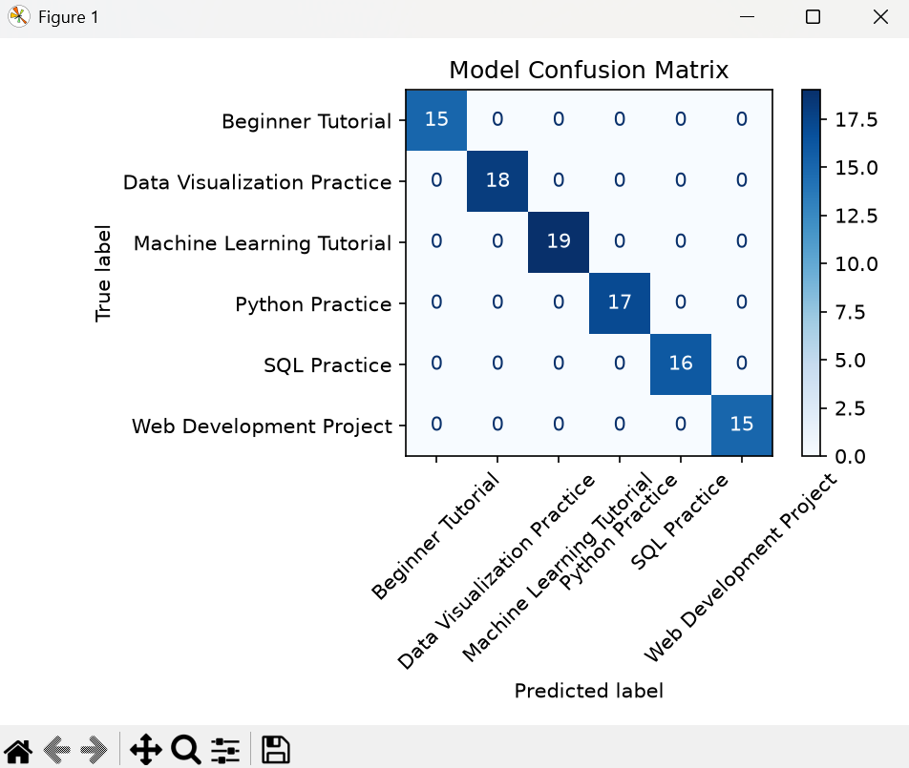
Testing & Results: Model Evaluation
10 • RESULTS
Confusion matrix
What the supplied output shows
• Six recommendation classes are displayed.
• The 100 test samples shown in the matrix fall on the diagonal (no off-diagonal errors visible).
• This corresponds to 100% accuracy for the displayed test split, if the matrix is from the same run.
• Because the labels are generated from synthetic rules, this result should not be treated as proof of real-world performance.
For a fairer evaluation, test with real student data and compare additional metrics across multiple splits.
14

Slide 14
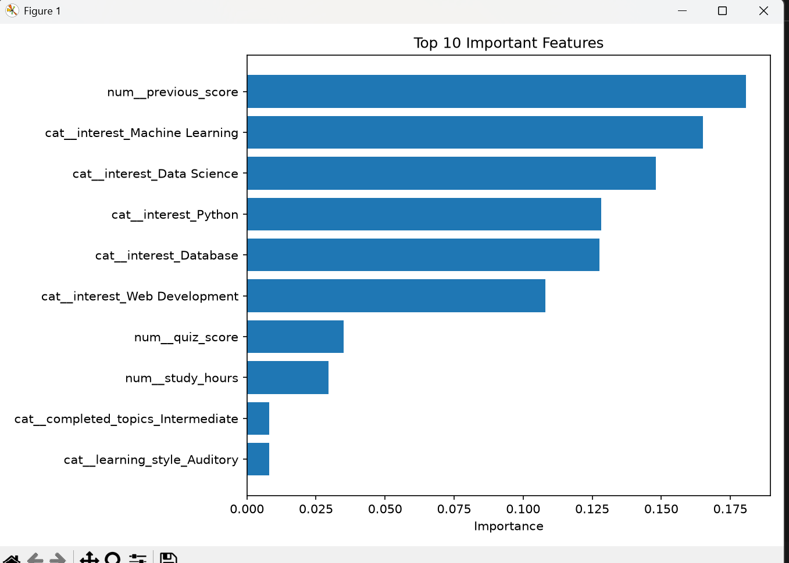
Testing & Results: Feature Importance
10 • RESULTS
The supplied feature-importance plot ranks the inputs used by the Random Forest model.
TOP FEATURE
Previous score has the highest importance in the supplied plot.
OTHER IMPORTANT INPUTS
Interest categories also contribute strongly to the model's decisions.
Feature importance indicates contribution within this trained model; it does not prove cause and effect.
15

Slide 15
Testing: Test Cases
10 • RESULTS
Test ID | Module | Expected / observed result | Status
TC-01 | Dataset generation | Script creates 500 records | Pass (as shown in project run)
TC-02 | Data quality check | Missing/duplicate counts are displayed | Pass (verify on each run)
TC-03 | Model training | Pipeline fits on training data | Pass (model output generated)
TC-04 | Model evaluation | Confusion matrix and metrics are produced | Pass (screenshots supplied)
TC-05 | New student input | Model returns a resource category | To be demonstrated
Note: Final test status should be confirmed by running the current script and entering a new student's details.
16

Slide 16
Conclusion
11 • SUMMARY
The project demonstrates a complete introductory machine-learning workflow for personalised learning-resource recommendation.
• A structured student-learning dataset is generated and saved.
• Exploratory graphs help describe the student data.
• A preprocessing pipeline and Random Forest classifier are trained.
• Evaluation outputs and feature-importance visualisation are produced.
• The prototype can predict a learning-resource category from student information.
The project meets the core prototype objective; further validation with real student data is needed.
17

Slide 17
Future Scope
12 • IMPROVEMENTS
• Collect a larger, anonymised dataset from real student learning activity.
• Improve recommendation quality using student feedback and learning outcomes.
• Compare Random Forest with other algorithms and tune model parameters.
• Add a user-friendly web interface with student login and recommendation history.
• Connect the system to a database or learning-management platform.
• Recommend specific courses, videos, exercises and next topics rather than only broad categories.
18

Slide 18
References
13 • SOURCES
• Python Software Foundation. Python Documentation. https://docs.python.org/3/
• The pandas development team. pandas Documentation. https://pandas.pydata.org/docs/
• NumPy Developers. NumPy Documentation. https://numpy.org/doc/
• Matplotlib Development Team. Matplotlib Documentation. https://matplotlib.org/stable/
• scikit-learn Developers. scikit-learn User Guide: preprocessing, Random Forest and model evaluation. https://scikit-learn.org/stable/user_guide.html
• Joblib Developers. Joblib Documentation. https://joblib.readthedocs.io/
• Project-generated synthetic student-learning dataset and output graphs (2026).
Thank you
19

